Slide 1
HOUSING USE CASE STUDY PROJECT INTRODUCTION
Houses are one of the necessary needs of each and every person around the globe and therefore housing and real estate market is one of the markets which is one of the major contributors in the world’s economy. It is a very large market and there are various companies working in the domain. Data science comes as a very important tool to solve problems in the domain to help the companies increase their overall revenue, profits, improving their marketing strategies and focusing on changing trends in house sales and purchases. Predictive modelling, Market mix modelling, recommendation systems are some of the machine learning techniques used for achieving the business goals for housing companies.

Slide 2
Data Pre-processing Done:
Before applying machine learning models to the dataset one should clean the data and this one has no exception in that sense. We perform some of the Exploratory Data Analysis (EDA) process.
Since the dataset contains both numerical and categorical features I have replaced a numerical feature with the mean values and categorical feature with the median values and dropped some of the NaN value rows using dropna() function. And since we have training data and testing data separately I have done this cleaning process for the both.
For the model to proceed with the data efficiently, the categorical variables should be encoded. Data has to be pre-processed as a machine learning models are better at reading numbers than words. Using get_dummies(), the categorical data can be replaced with numbers with increasing the features. But before encoding I have merged both train and test data row wise in order to avoid the mismatch in the number of columns. And scaled a data using the MinMaxScaler in order to obtain a better predictions.

Slide 3
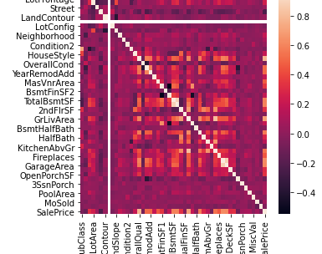
Data Inputs-Logic-Output Relationships:
The correlation heatmap using seaborn library which shows the relation between each feature with the target feature which as shown below.
The darker shades shows highly negative correlation and the lighter shades shows highly positive correlation. Corresponding to the target feature we can see that “OverallCond” and “YearRemodAdd” features has very positive correlation with the target. Which implies the house having good facilities and if it is recently modified then that house will have more price. And remaining features are also contributing to the target that is they are also playing a major role in predicting price of the house.

Slide 4
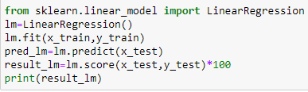
Models Development and Evaluation:
Linear Regression: It is a basic and commonly used type of predictive analysis. Linear Regression fits a straight line or surface that minimizes the deprecancies between predicted and actual output values.

Slide 5
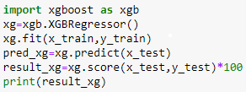

Models Development and Evaluation
XGBoost Regressor
Decision Tree Regressor
Extreme Gradient Boosting regressor provides an efficient and effective implementation of gradient boosting algorithm which is used for regression predictive modeling.
This algorithm splits a data sample into two or more homogeneous sets based on the input variables. A part of a tree is generated with each split.

Slide 6


Models Development and Evaluation
Gradient Boosting Regressor
Random Forest Regressor
Gradient boosting is a machine learning technique for regression, which produces a prediction model in the form of an ensemble of weak prediction models, typically decision trees.
It is a type of ensemble learning method that uses numerous decision trees to achieve higher prediction accuracy and model stability.

Slide 7
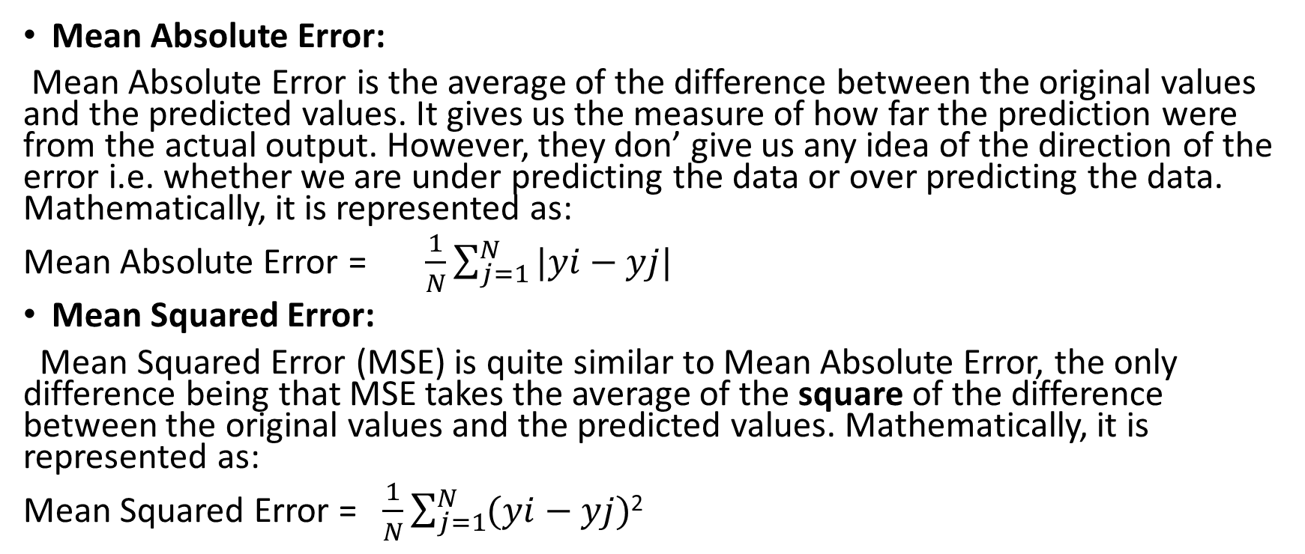
Key metrics for success in solving problem under consideration.
Mean Absolute Error:
Mean Absolute Error is the average of the difference between the original values and the predicted values. It gives us the measure of how far the prediction were from the actual output. However, they don’ give us any idea of the direction of the error i.e. whether we are under predicting the data or over predicting the data. Mathematically, it is represented as:
Mean Absolute Error = $\frac{1}{N}\sum_{j=1}^{N}{|yi−yj|}$
Mean Squared Error:
Mean Squared Error (MSE) is quite similar to Mean Absolute Error, the only difference being that MSE takes the average of the square of the difference between the original values and the predicted values. Mathematically, it is represented as:
Mean Squared Error = $\frac{1}{N}\sum_{j=1}^{N}{(yi−yj)}$²

Slide 8
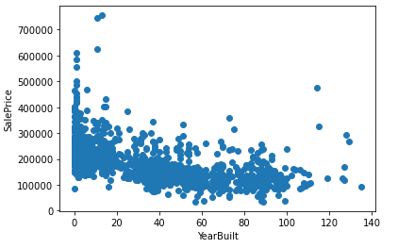
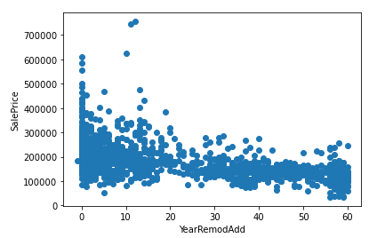
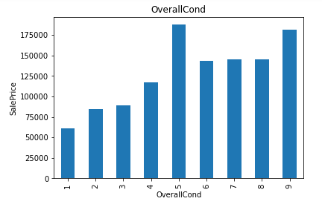
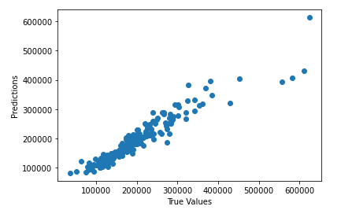
Thus when we compared all the accuracy scores and metrics we got to know that the Gradient Boosting Regressor is giving a good accuracy along with the linear line when we plotted (scatter). Thus I have finalized that this model and tuned using hyper parameters in which its accuracy was improved.

Slide 9
Conclusion
Key findings: Highest accuracy is seen in the Gradient Boosting Regressor which is similar to the k-fold cross validation score (for k=5) and also less MAE and MSE and improved accuracy after fine tuning of the same model.
Things I've learned by completing this project:
How to use NumPy to investigate the latent features of a dataset.
How to analyse various learning performance plots for variance and bias.
How to determine the best-guess model for predictions from unseen data.
How to evaluate a model's performance on unseen data using previous data.

Slide 10


